Slide 1
The Faces of Canadian Money
Reach for the Top
Evan Sauve

Slide 2
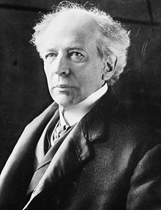
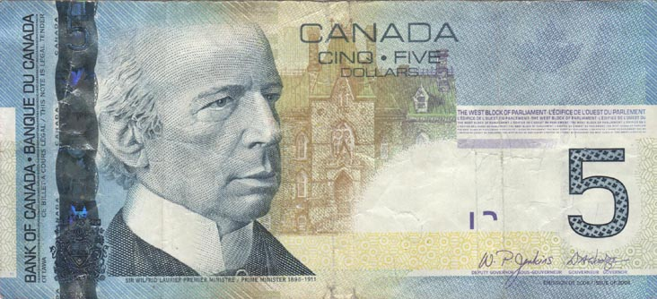
Sir Wilfrid Laurier
I was born on November 20th, 1841 and I appear on the Canadian $5 bill.
I was Canada’s seventh prime minister, taking over in 1896.
I was Canada’s first francophone prime minister.
A 15-year era of Canadian history is named after me. Also, a university in Kitchener/Waterloo is named after me.

Slide 3
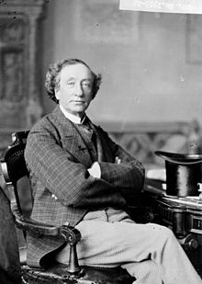
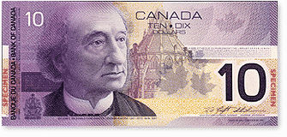
Sir John A. MacDonald
I was born January 11th, 1815 in Glasgow, Scotland. I appear on the Canadian $10 bill.
My political career lasted for about half a century.
My middle name is Alexander.
I served as Canada’s prime minister for 19 years, second to only Mackenzie King. I am best known as Canada’s first prime minister.

Slide 4
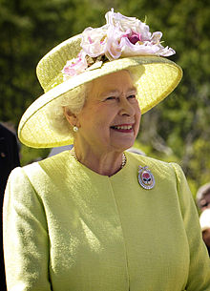
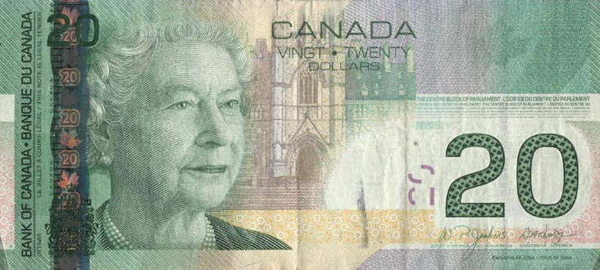
Queen Elizabeth II
I was born on April 21st, 1926 and I appear on the Canadian $20 bill.
In 1947, I married the Duke of Edinburgh. His name is Phillip.
My father and predecessor was King George VI.
On February 6th, 1952, I was crowned Head of the Commonwealth.

Slide 5
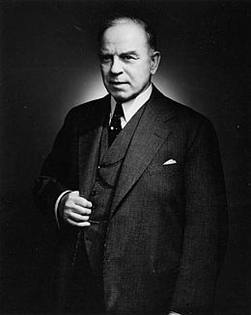
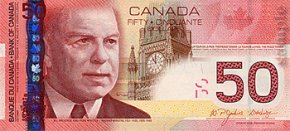
William Lyon Mackenzie King
I was born December 17th, 1874 in Berlin, Ontario. I appear on the Canadian $50 bill.
I was the tenth prime minister of Canada.
I was trained in law and social work. Politically, I represented the Liberal Party of Canada.
I am well-known for serving Canada in three separate terms, serving a total of 22 years, the longest of any prime minister.

Slide 6
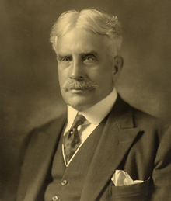
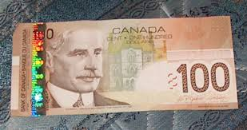
Sir Robert Borden
I was born June 26th, 1854. I appear on the Canadian $100 bill.
I was the third Nova Scotian prime minister. I served as Canada’s eighth prime minister.
In addition to politics, I was a lawyer. After retiring from public life, I became a chancellor at Queen’s University.
I am well-known as Canada’s prime minister during WWI.

